Slide 1
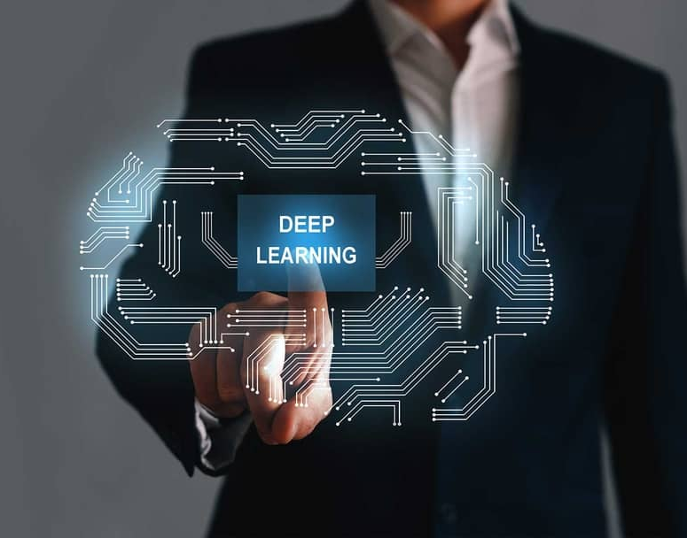
Network Compression and Its Application
Yan Yan
Illinois Institute of Technology
03/31/2023

Slide 2
Outline
Background:
Network Pruning
Network Quantization
Knowledge Distillation
Research work:
Lipschitz Continuity Guided Knowledge Distillation (ICCV 2021)
Network Binarization via Contrastive Learning (ECCV 2022)
Post-training Quantization on Diffusion Model (CVPR 2023)
Notes:
Here is the outline of today’s presentation.
First,
Especially, I would like to highlight the key motivation of network compression, the invariance discovery.
Then, I will go deeper into my completed works. Some of them are the recent state-of-the-arts in their corresponding areas.
I will talk about a KD method called Lipschitz Continuity Guided Knowledge Distillation, and a network quantization method called Network Binarization via Contrastive Learning
Finally, I will talk about the our in progress work.

Slide 3
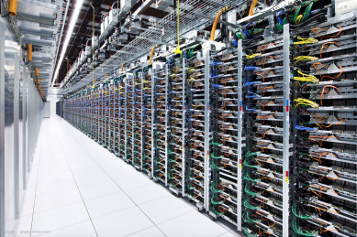


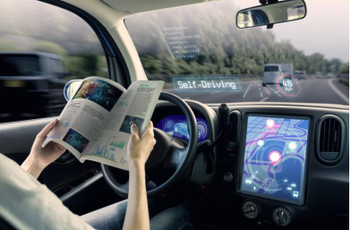
Efficient AI
GAP
Large neural networks require:
Critical to resource constrained environments
Memory &
Computations
Power Consumption
Embedded systems
e.g., mobile devices
Real-time tasks,
e.g., auto-cars
Notes:
So, what is efficient ai? Why we need efficient ai?
Nowadays, AI algorithms especially deep neural network-based methods have achieved great success in real world. For example, google net can beat humans on image classification task. And xxxx
However, those large neural networks requires large amount of Memory & Computational resources, and their power consumption is also huge.
But their application senorioes are always correlated with edge-devices, such as Embedded systems on mobile devices and Real-time tasks on auto-cars.
We can say there is a huge gap between deep learning algorithms and their applications.

Slide 4
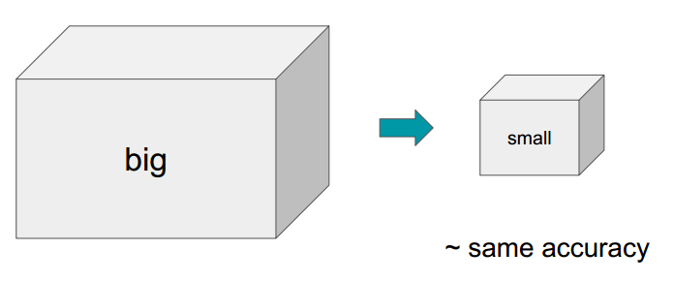
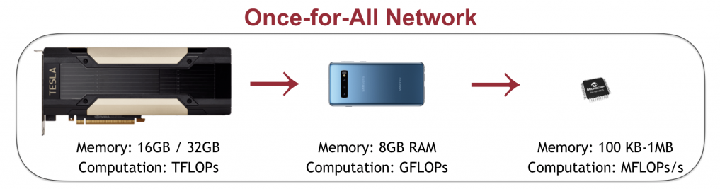
Network Compression
The goal is to reduce the size of neural network without compromising accuracy.
Notes:
To handle this gap, network compression is proposed.
The goal is to reduce the size of neural network without compromising accuracy.
In reality, our goal is to gradually move the deep learning algorithms from large devices such as GPU to smaller devices such mobile devices, and eventually we hope we can deploy those algorithms on a very small devices such as FPGA chips.

Slide 5
Network Compression Paradigms
Network Pruning
Network Quantization
Knowledge Distillation
Notes:
Generally, there are three paradigms for network compression
Xxx xxxx xxx
Here, I would like to note that those paradigms are orthogonal, which means they can be combined with each other, realizing further compression.
For example, after getting a pruned network, we can also implement quantization on the pruned network. After we get the quantized and pruned network, we can also implement KD technique on it to recover its performance.

Slide 6
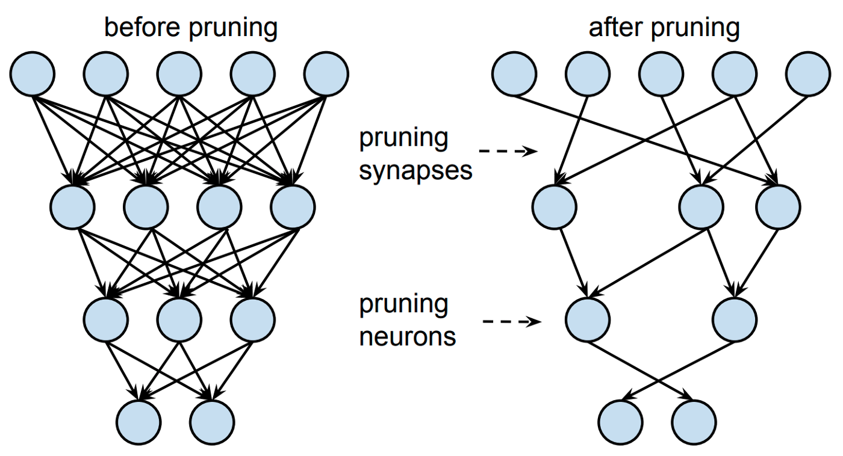
Network Pruning
Set individual parameters to zero and make the network sparse.
Or remove entire nodes from the network.
Optimal Brain Damage [NeurIPS 1989 Y. LeCun et al.]
Notes:
This is the most intuitive network compression method.
We can guess from the name itself.
Actually, network pruning is proposed just after the big success of LeNet for hand writing number recognition by Yann lecun.

Slide 7
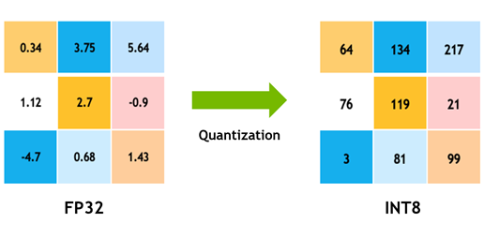
Network Quantization
Reduce the precision of the weights, biases, and activations such that they consume less memory.
Going from 32-bit to 8-bit, for example, would reduce the model size by a factor of 4, so one obvious benefit of quantization is a significant reduction in memory.
Quantized Neural Networks [JMLR 2017 I. Hubara et al.]

Slide 8
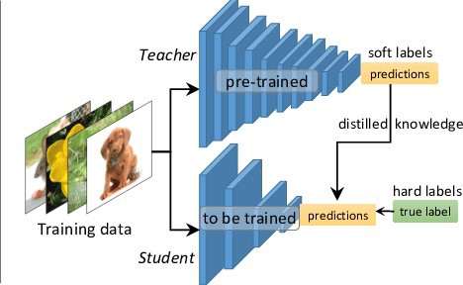
Knowledge Distillation
Transfer the knowledge from a large model or set of models to a single smaller model.
Distilling the knowledge in a neural network
[ArXiv 2015 G. Hinton et al.]
Notes:
The last one, Knoeledge distillation. This one is a little tricky, we cannot directly guess what it does by its name, like pruning and quantization.
But the core idea is still simple. Say we have a large model and a small model. Of course the performance of small model is bad. Can we use the large model to guide the small model?
This is what knowledge distillation does.

Slide 9
Key Motivation
Discover the invariance in neural networks, and leverage it for network compression.
We have explored those invariance from three perspectives, functional, statistical and causal perspectives.
Matching
Invariance
Notes:
After briefly reviewing the paradigms for network compression, we can summarize that the key motivation is to find the invariance of neural network, and preserve it while compressing network.
In other words, we need to Discover the invariance in neural networks, and leverage it for network compression
We have explored those invariance from three perspectives, functional, statistical and causal perspectives.
Specifically, we

Slide 10
Lipschitz Continuity Guided Knowledge Distillation
Yuzhang Shang, Bin Duan, Ziliang Zong, Liqiang Nie, Yan Yan. IEEE International Conference on Computer Vision (ICCV), 2021
Notes:
Next, I would like to introduce my completed work, the first one is about knowledge distillation.
It is named Lipschitz Continuity Guided Knowledge Distillation.

Slide 11
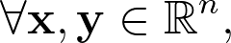
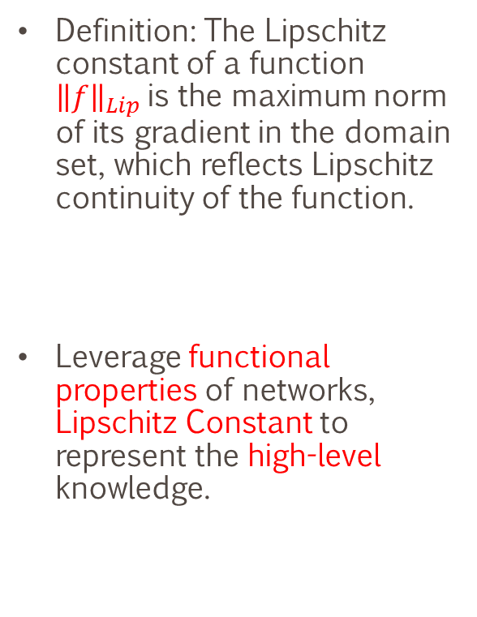
Motivations
Definition: The Lipschitz constant of a function ${\left\|f\right\|}_{Lip}$is the maximum norm of its gradient in the domain set, which reflects Lipschitz continuity of the function.
Leverage functional properties of networks, Lipschitz Constant to represent the high-level knowledge.

Slide 12
Background of Lipschitz Constant
Researchers used Spectral Normalization, to smooth the discriminator function in GAN for synthesizing realistic image. [Miyato et al. ICLR 2018]
In adversarial attack machine learning, authors propose constraining local Lipschitz constants of neural networks to avoid adversarial attacks. [Weng et al. ICLR 2018]
Many studies underline the significance of Lipschitz constant in neural networks' expressiveness and robustness. [Neyshabur et al. NeurIPS 2017]

Slide 13
LONDON: Lipschitz Continuity Guided Knowledge Distillation
Module-wisely, instead of layer-wisely.
Design a series of Transmitting Matrix to avoid NP-hard computation.
Loss function:

Slide 14
Transmitting Matrix
A novel method to approximate the Lipschitz constants of neural networks.
Take fully advantage of the feature maps.
Prove the effectiveness of LONDON.

Slide 15
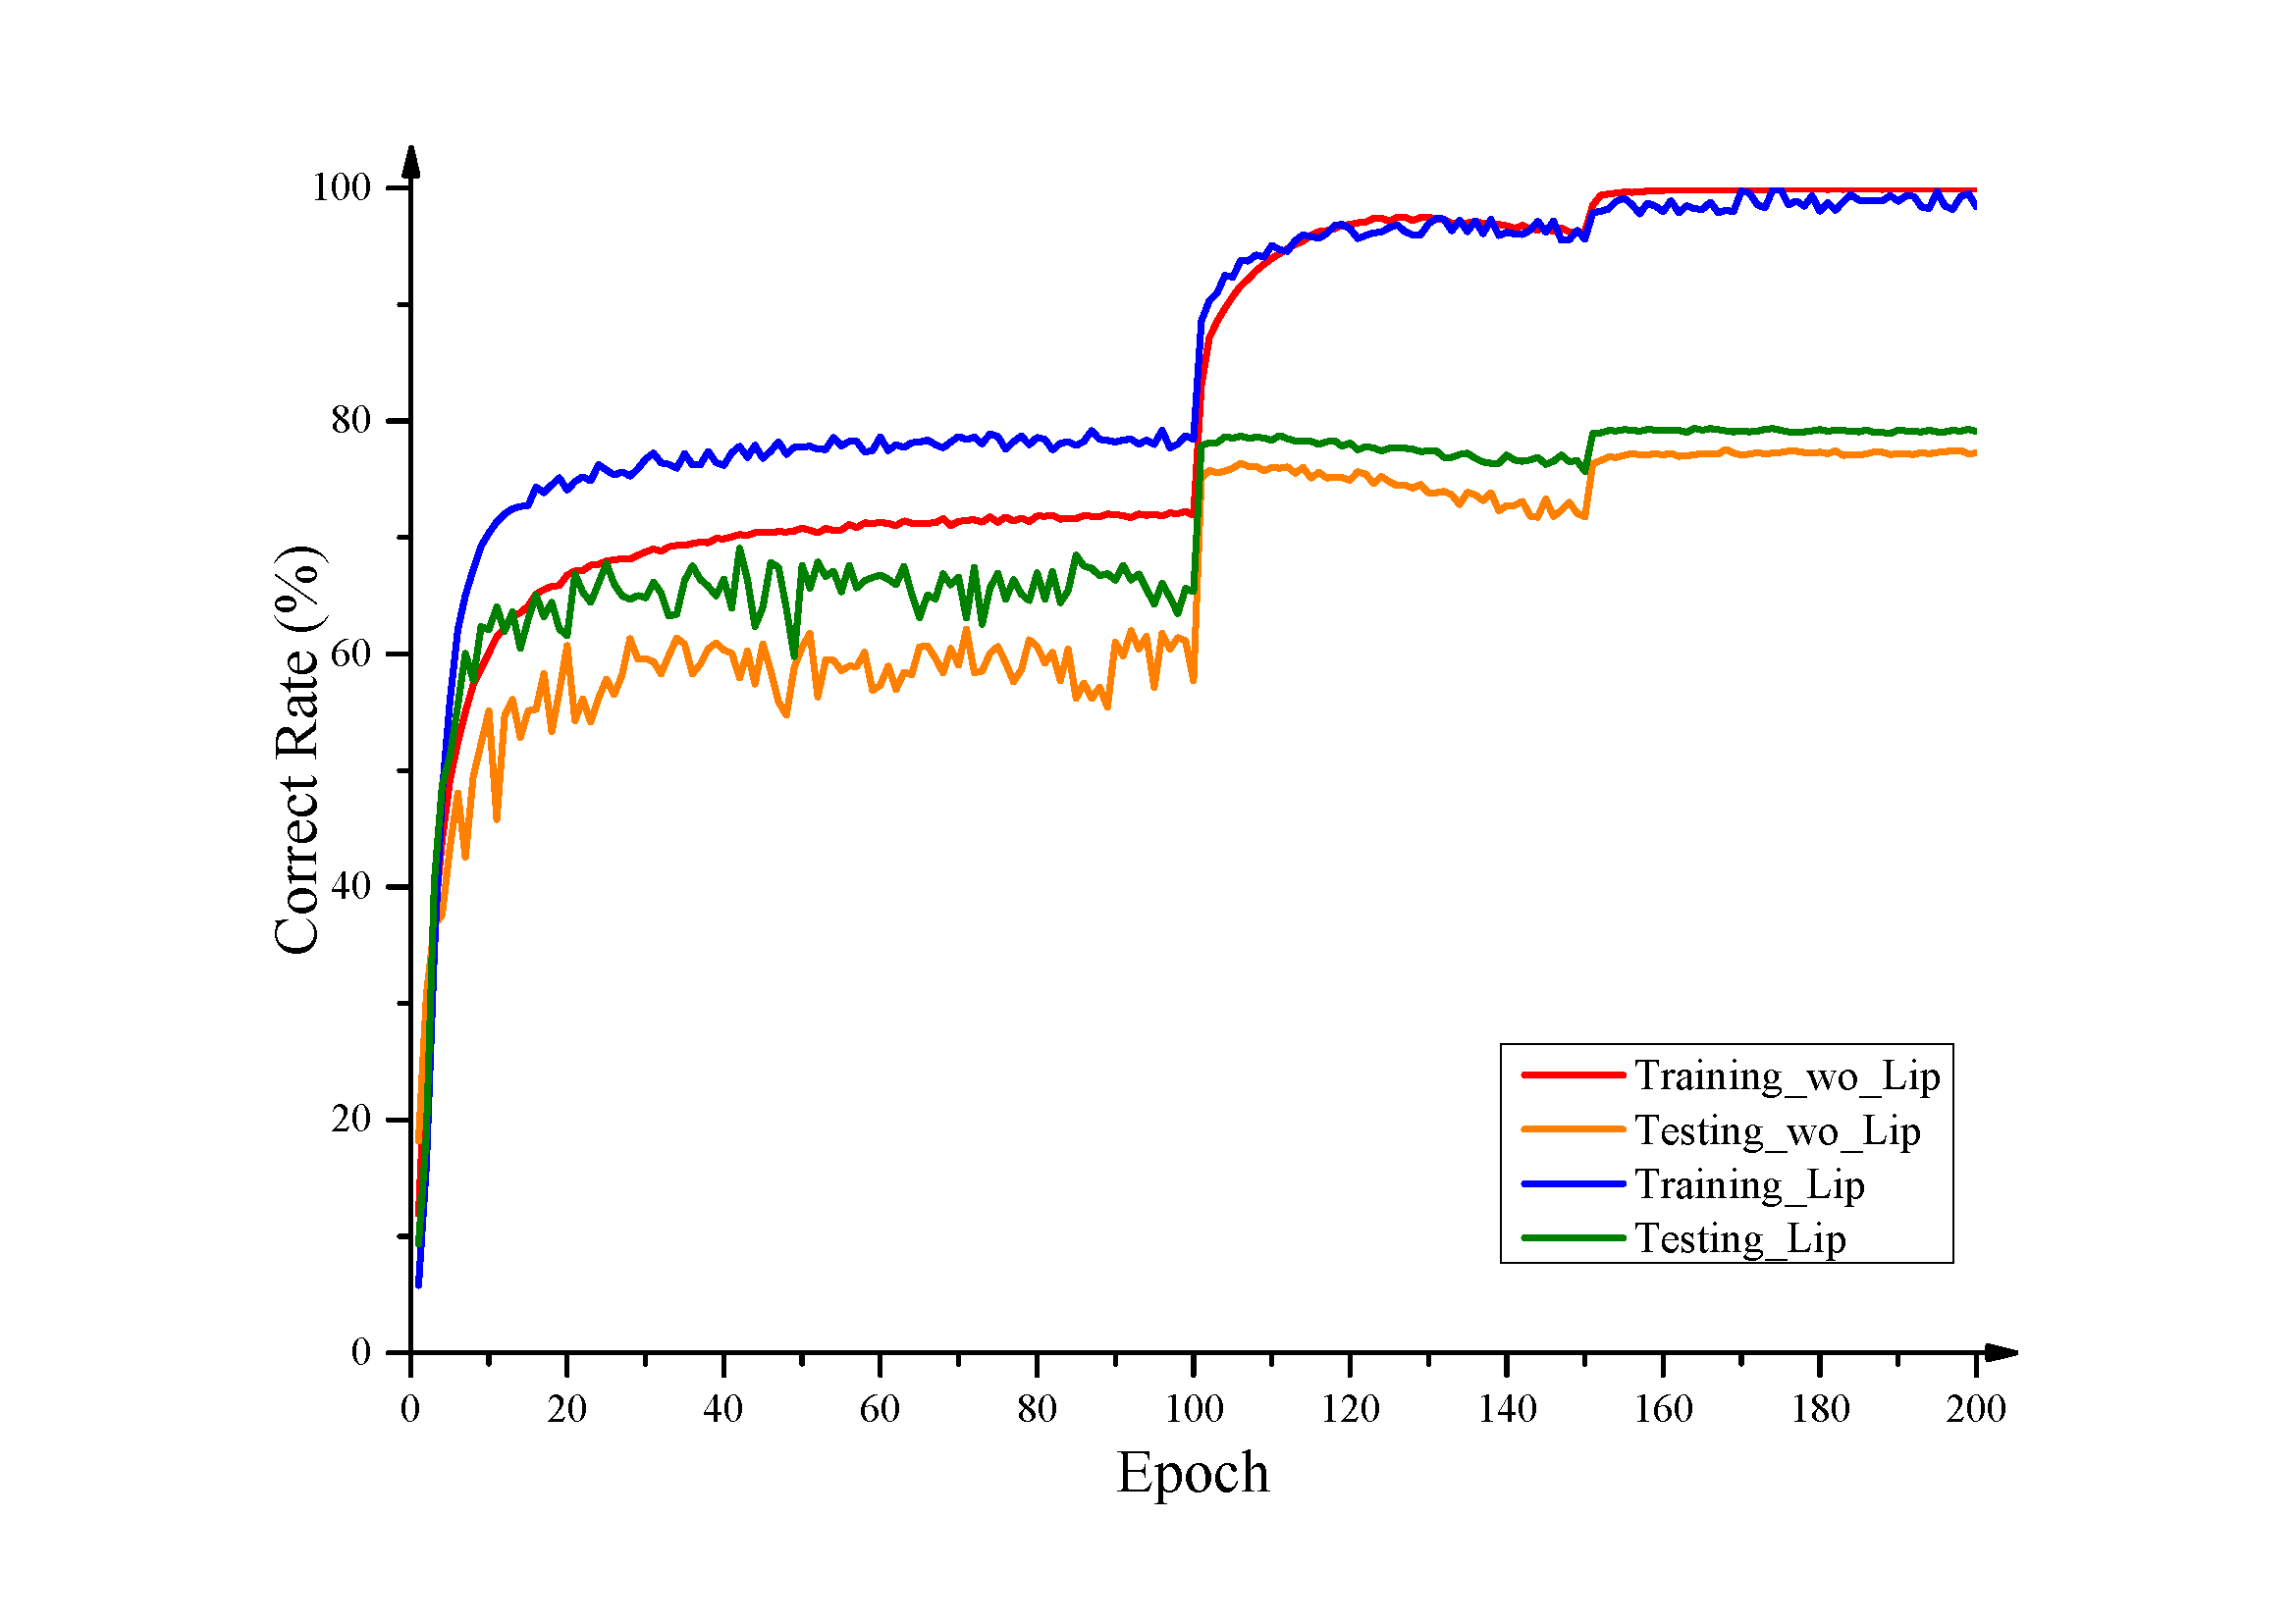
Mitigate Overfitting
The Lipschitz distillation can be seen as a regularization term.

Slide 16
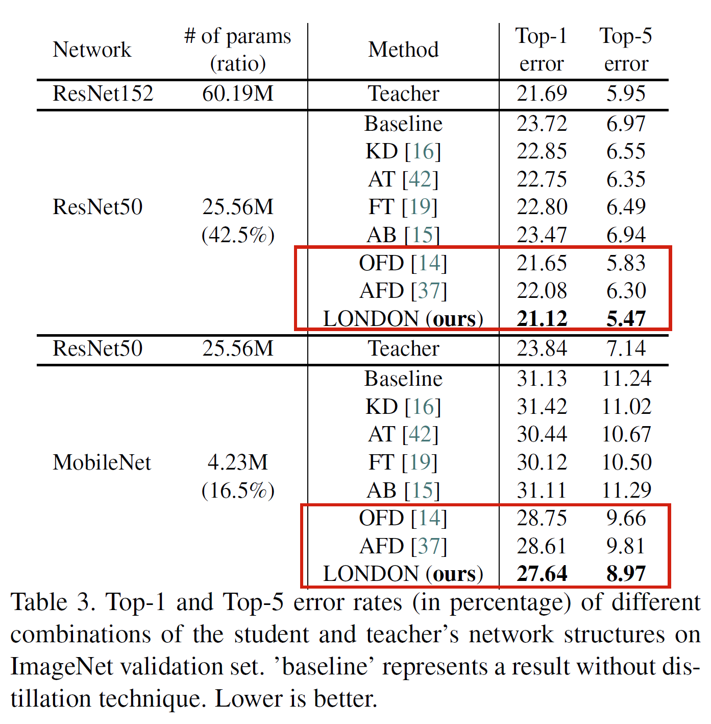
Results on ImageNet Classification
Improve 1% accuracy.
Plug-and-play in different architectures.

Slide 17
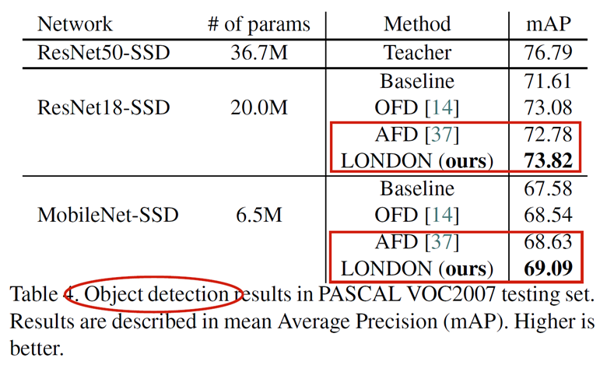
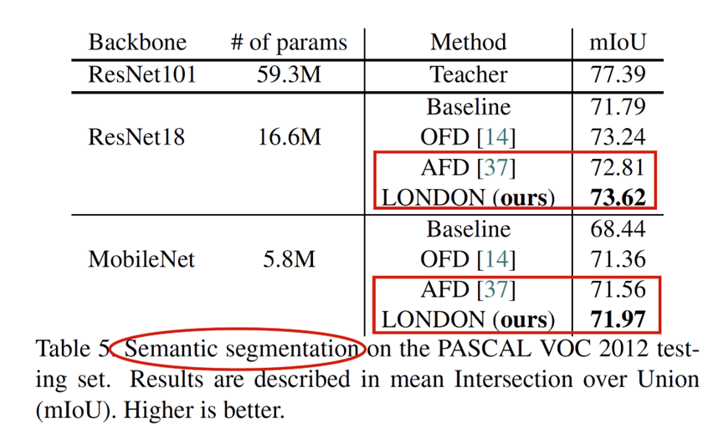
Results on Object Detection and Segmentation

Slide 18
Network Binarization via Contrastive Learning
Yuzhang Shang, Dan Xu, Ziliang Zong, Liqiang Nie, Yan Yan; European Conference on Computer Vision (ECCV), 2022

Slide 19
Problems of Existing Binarization Methods
As the quantization error caused by weights binarization has been reduced in earlier works.
The activations binarization becomes the major obstacle for further improvement of the accuracy.
Sharing information between float-point and binary activations have never been considered.

Slide 20
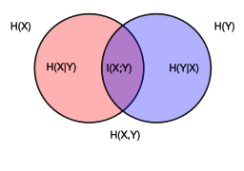
Motivations
To mitigate the information degradation caused by the binarization operation from FP to binary activations
We establish a contrastive learning framework while training BNNs through the lens of Mutual Information (MI) maximization.
Mutual Information (MI, $I(X;Y)$) between two variables

Slide 21
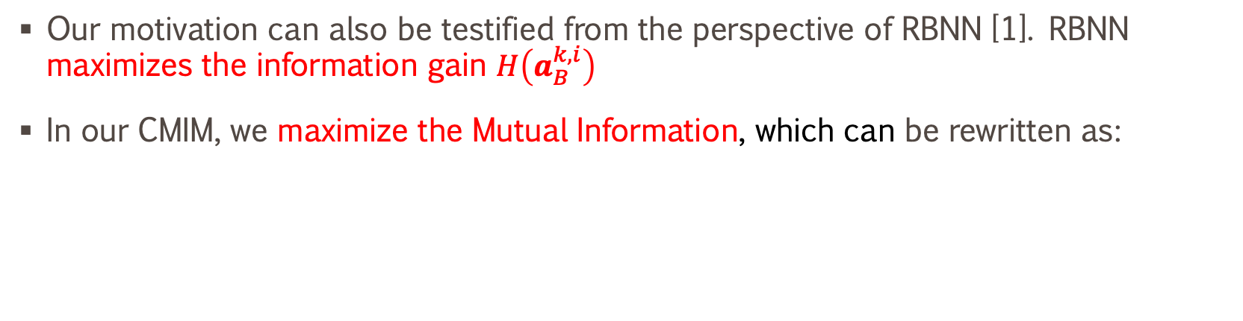
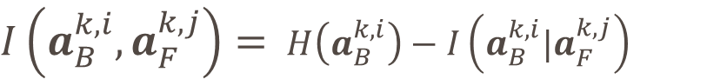
Mutual Information and Contrastive Learning
Our motivation can also be testified from the perspective of RBNN [1]. RBNN maximizes the information gain $H\left(a_{B}^{k,i}\right)$
In our CMIM, we maximize the Mutual Information, which can be rewritten as:
$I\left(a_{B}^{k,i},a_{F}^{k,j}\right)=$ $H\left(a_{B}^{k,i}\right)−I\left(a_{B}^{k,i}|a_{F}^{k,j}\right)$
[1] Rotated Binary Neural Network in NeurIPS 2020 M. Lin et al.
Notes:
Explain the equation

Slide 22
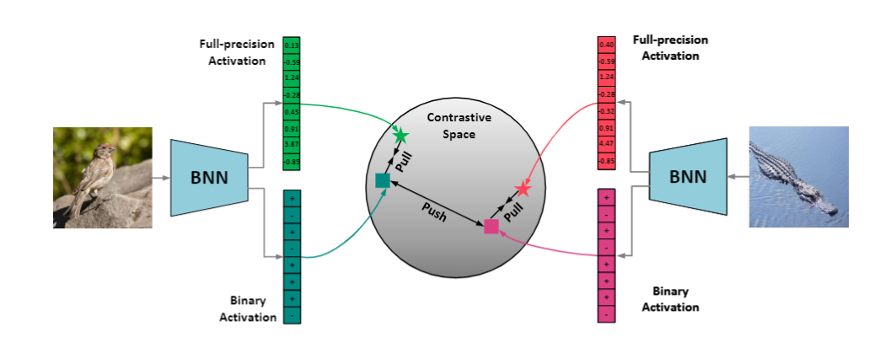
CMIM: Network Binarization via Contrastive Learning
Feeding two images into a BNN, and obtaining the three pairs of binary and full-precision activations.
Our goal is to embed the activations into a contrastive space, then learn from the pair correlation with the contrastive learning task.

Slide 23
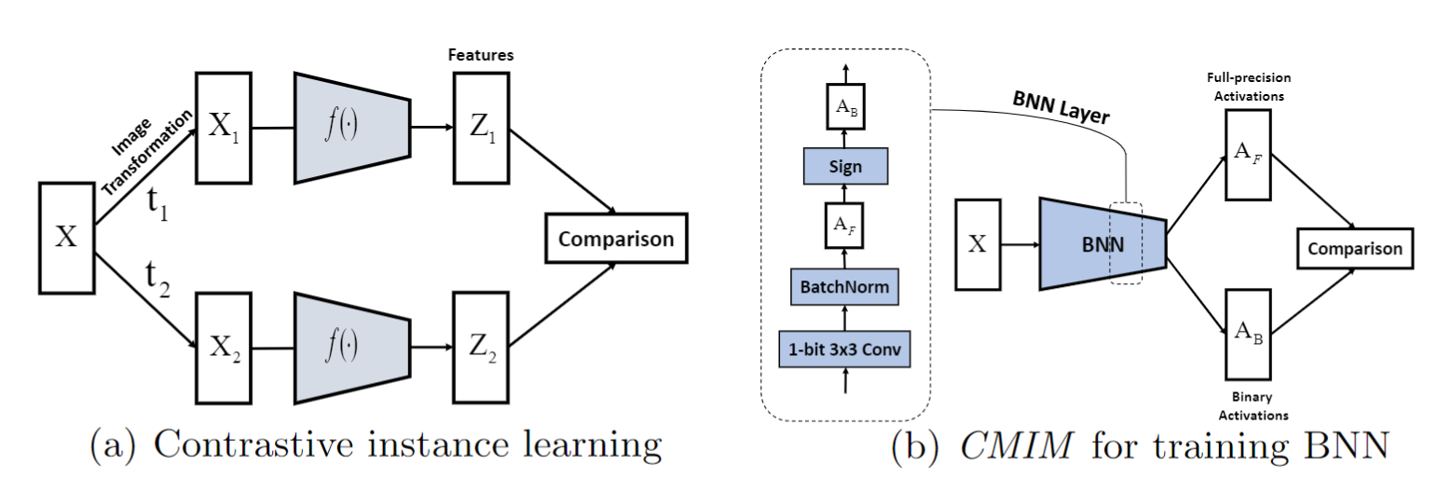
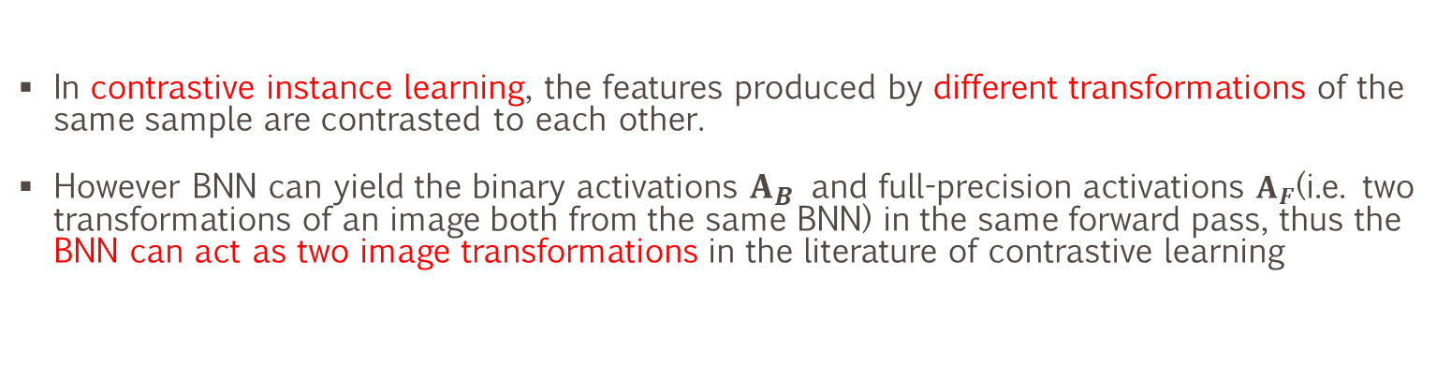
Intuitive Explanation
In contrastive instance learning, the features produced by different transformations of the same sample are contrasted to each other.
However BNN can yield the binary activations $A_{B}$ and full-precision activations $A_{F}$(i.e. two transformations of an image both from the same BNN) in the same forward pass, thus the BNN can act as two image transformations in the literature of contrastive learning

Slide 24
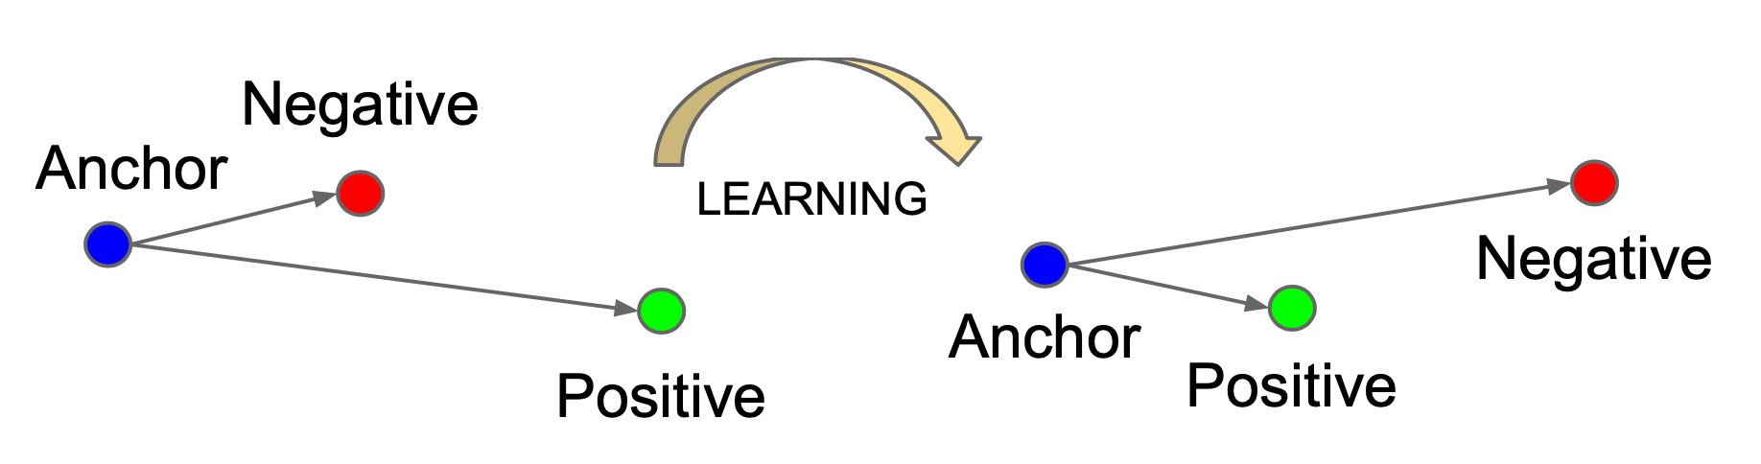
Contrastive Loss for Binarization
We define the contrastive loss function NCE between the k-th layer’s activations:

Slide 25
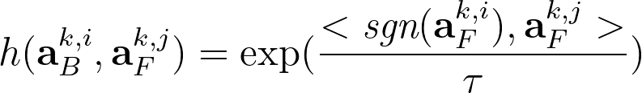
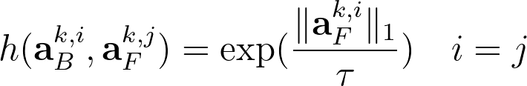
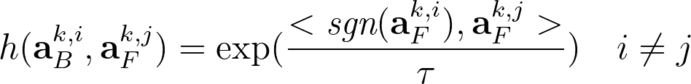
Critic Function for Binary Activations
Working mechanism of CMIM from a perspective of activation flip.
Turn the + activation into -, binary activation in the critic can pull the activations in positive pair close and push the ones in the negative pair away via inner product.
Citric Function:
Citric Function:

Slide 26
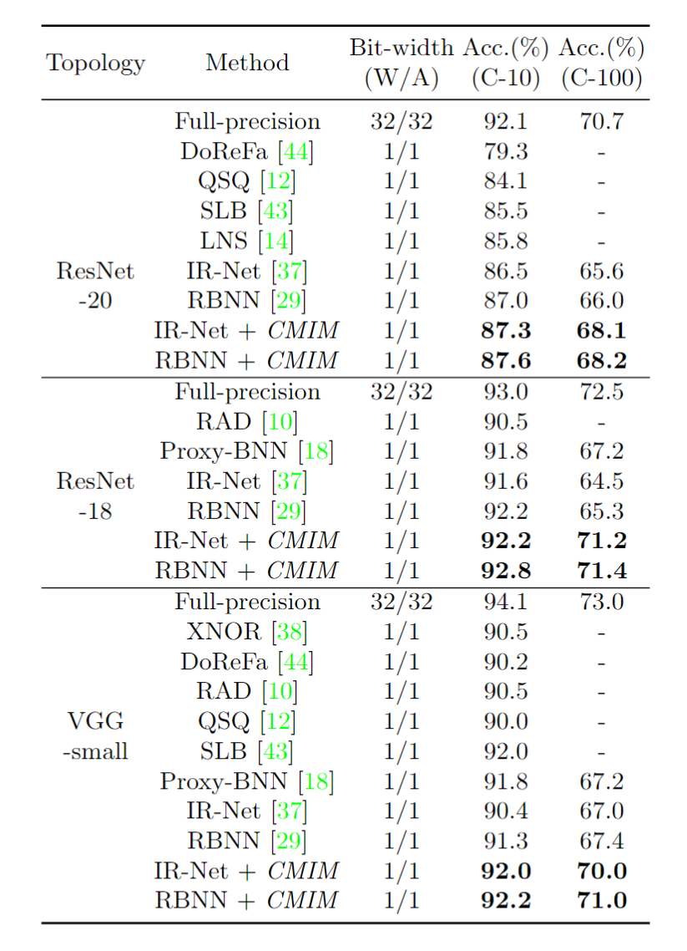
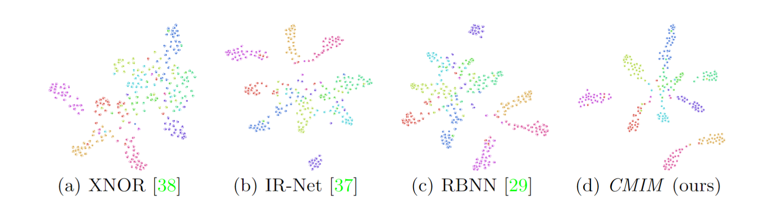
Experimental Results
Our method can endow BNN more representative ability.
Improve BNN SoTA by 3%.
Plug-and-play in different architectures.

Slide 27
Post-training Quantization on Diffusion Models
Yuzhang Shang, Zhihang Yuan, Bin Xie, Bingzhe Wu, Yan Yan; IEEE Conference on Computer Vision and Pattern Recognition (CVPR), 2023

Slide 28
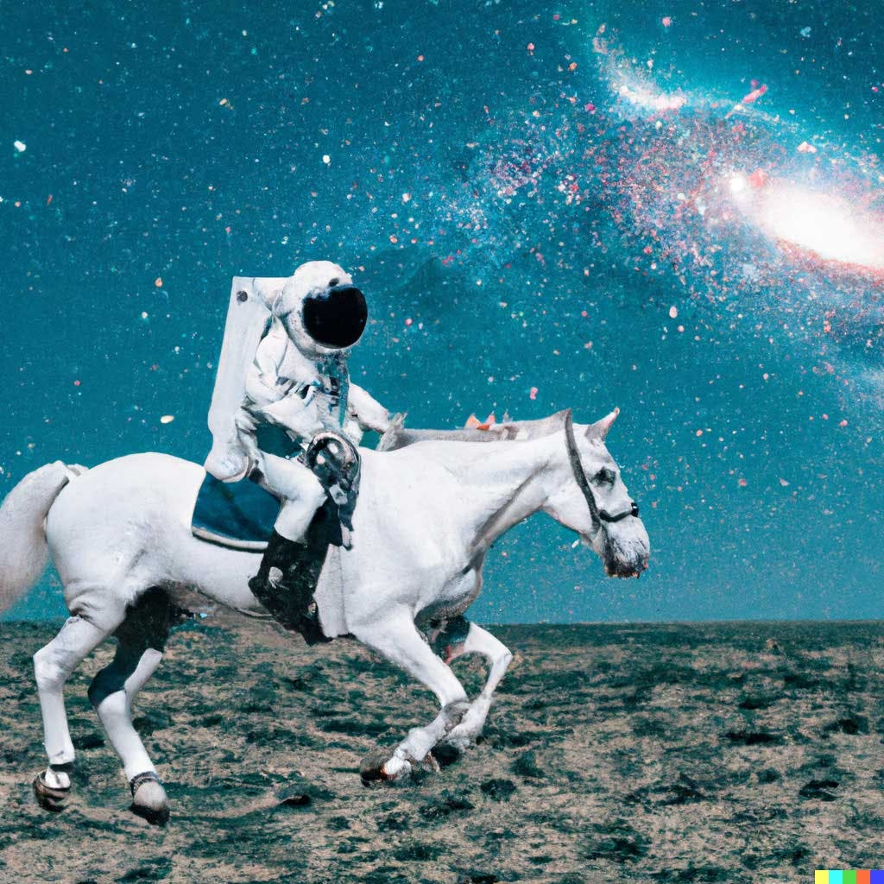

Background: DALL·E 2
Input: An astronaut riding a horse in photorealistic style.
Notes:
DALL·E 2 can create original, realistic images and art from a text description. It can combine concepts, attributes, and styles.

Slide 29
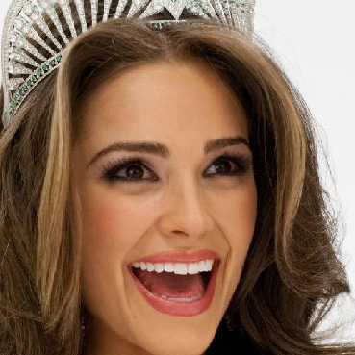
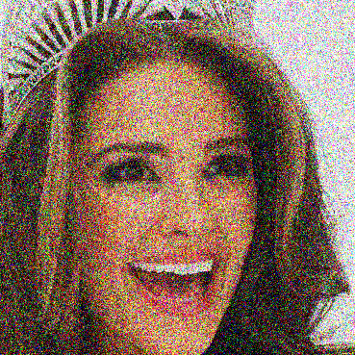
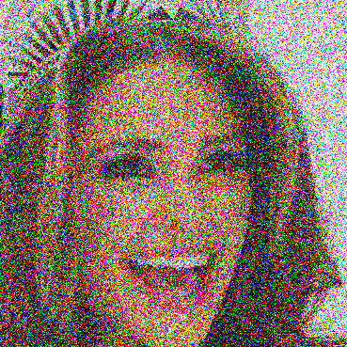

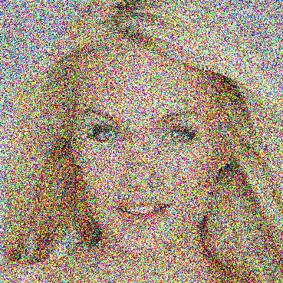
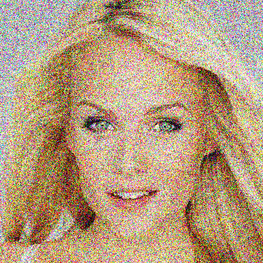
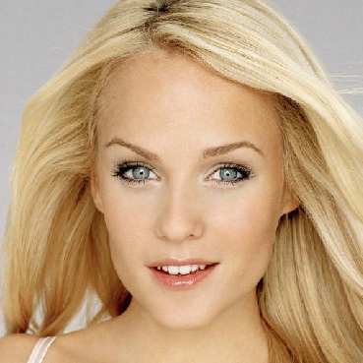
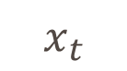
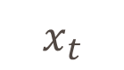
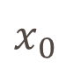

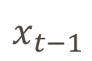
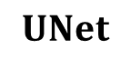
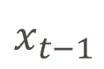
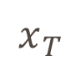
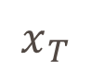
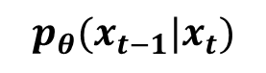
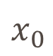
Background: Diffusion Models
Diffusion
Process
$${q(x}_{t}|x_{t−1})$$
$$x_{0}$$
$$x_{t−1}$$
$$x_{t}$$
$$x_{T}$$
$$UNet$$
Denoising
Process
En-coder
De-coder
$$x_{T}$$
$$x_{t}$$
$${p_{θ}(x}_{t−1}|x_{t})$$
$$x_{t−1}$$
$$x_{0}$$
The goal of diffusion models is to learn the latent structure of a dataset by modeling the way in which data points diffuse through the latent space.
A neural network is trained to denoise images blurred with Gaussian noise by learning to reverse the diffusion process.

Slide 30
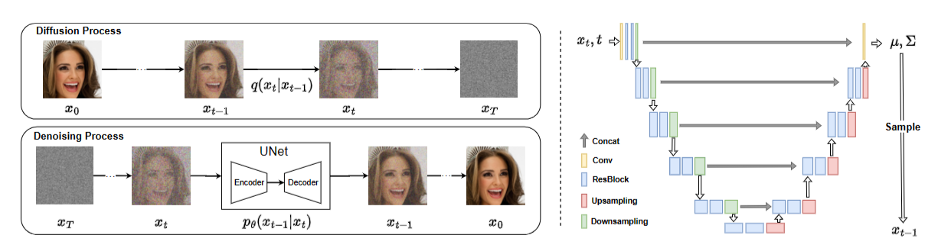
Motivations
The cost of generating a sample is unacceptable.
Two orthogonal factors slow down the denoising process:
i) lengthy iterations for sampling images from noise,
ii) a cumbersome network for estimating noise in each iteration.

Slide 31
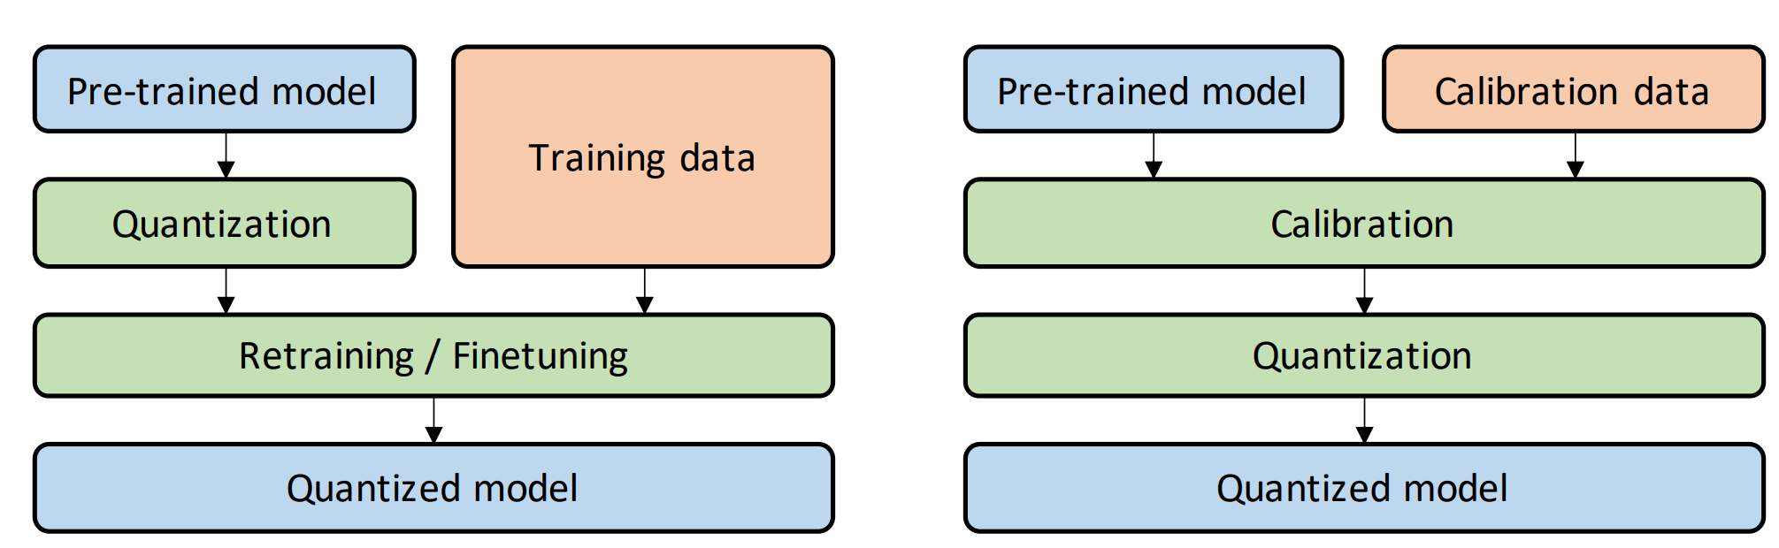
Post Training Quantization (PTQ)
Quantization-Aware Training (QAT)
Post-Training Quantization (PTQ)
Training Data FREE!
In QAT, a pre-trained model is quantized and then finetuned using training data to adjust parameters and recover accuracy degradation.
In PTQ, a pre-trained model is calibrated using calibration data (e.g., a small subset of training data) to compute the clipping ranges and the scaling factors.
Notes:
What is Post Training Quantization (PTQ)? Comparison between Quantization-Aware Training and Post-Training Quantization. In QAT, a pre-trained model is quantized and then finetuned using training data to adjust parameters and recover accuracy degradation. In PTQ, a pre-trained model is calibrated using calibration data (e.g., a small subset of training data) to compute the clipping ranges and the scaling factors. Then, the model is quantized based on the calibration result.

Slide 32
Why we need Post-Training Quantization?
Why we need Quantization? (Example: Int8 network is 10x faster than float32 network.)
Reduce model size so that it can be deployed on resource-constrained devices.
Reading and writing data from global memory are expensive, often requiring hundreds of cycles.
Why we need Post-Training manner?
Quantization via model re-training (Quantization-Aware Training method) is computational expensive.
Float32 models are always accessible, but training data are not accessible.

Slide 33
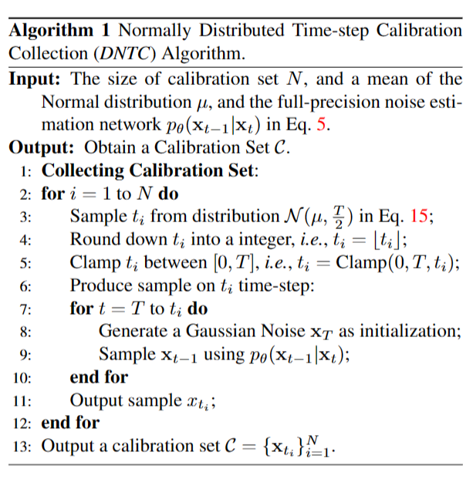
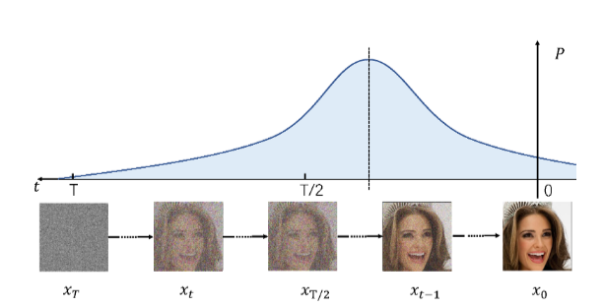
Normally Distributed Time-step Calibration
We desire the calibration samples:
Generated by the denoising process with the full-precision diffusion model.
Relatively close to clean images and far away from noise.
Covered by various time-steps.

Slide 34
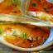
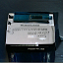
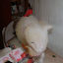














































Experimental Results
Speedup diffusion models 4 times while maintaining comparable performance.

Slide 35
Other Work Directions
Efficient AI
General network compression methods.
Data-free / post-training compression.
Diffusion model acceleration.
Causality + Compression.

Slide 36
Thanks!
Q&A

